Slide 1


Connections Made From Shared Interests
Notes:
Home Page

Slide 2

Let me ask you a question
How many times have you found yourself alone?
Notes:
James Page 1: Intro

Slide 3

The Challenge
Isolated Campus Experience
Despite hyper-connectivity, students face unprecedented isolation from campus and university life.
Students struggle to take the first step to connect.
Starting a conversation is difficult, especially with a stranger.
What if there was a way to find like-minded individuals?
Notes:
James Page 2: Main Part

Slide 4

The University Connection Revolution
Notes:
James page 3: Transition Page

Slide 5
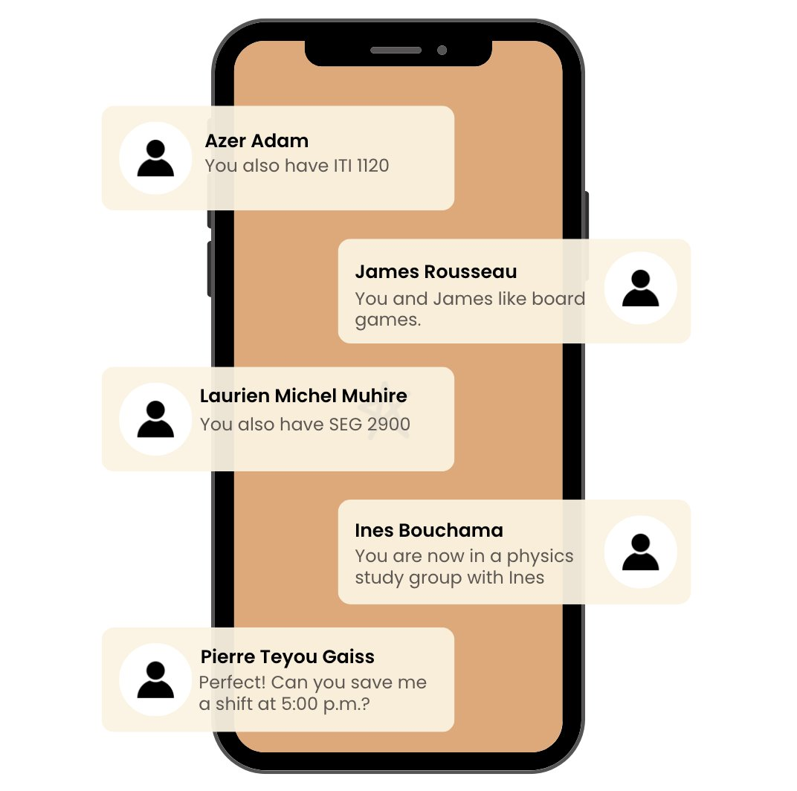
Our Answer
“Links”
Allow university students to discover new people and forge new connections based on common interests
Build authentic campus relationships
Find study partners & classmates
Discover relevant clubs & events
Notes:
2.Ines: Solution page

Slide 6
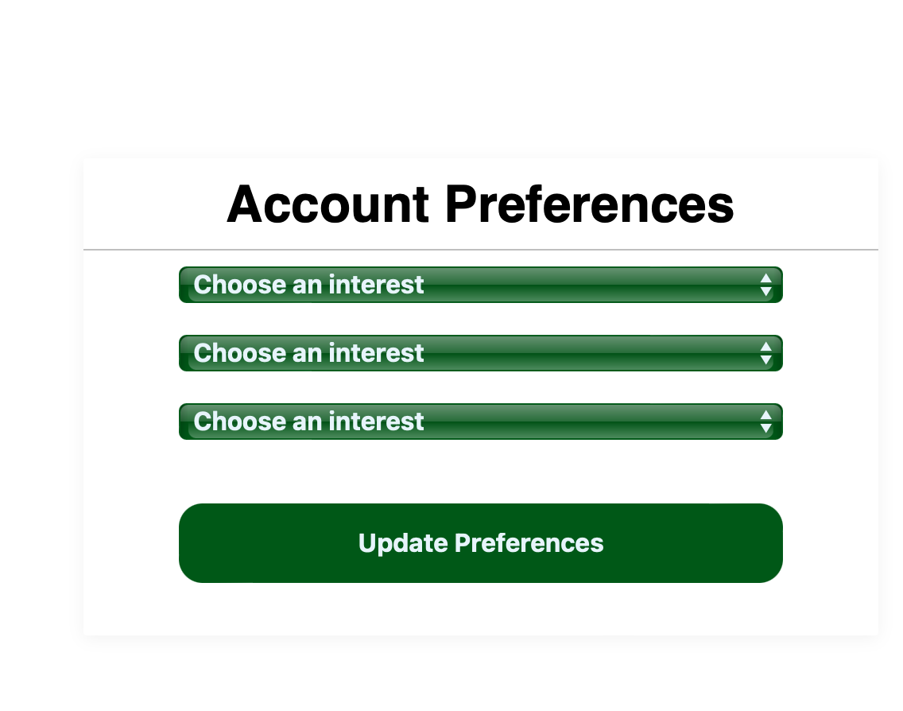
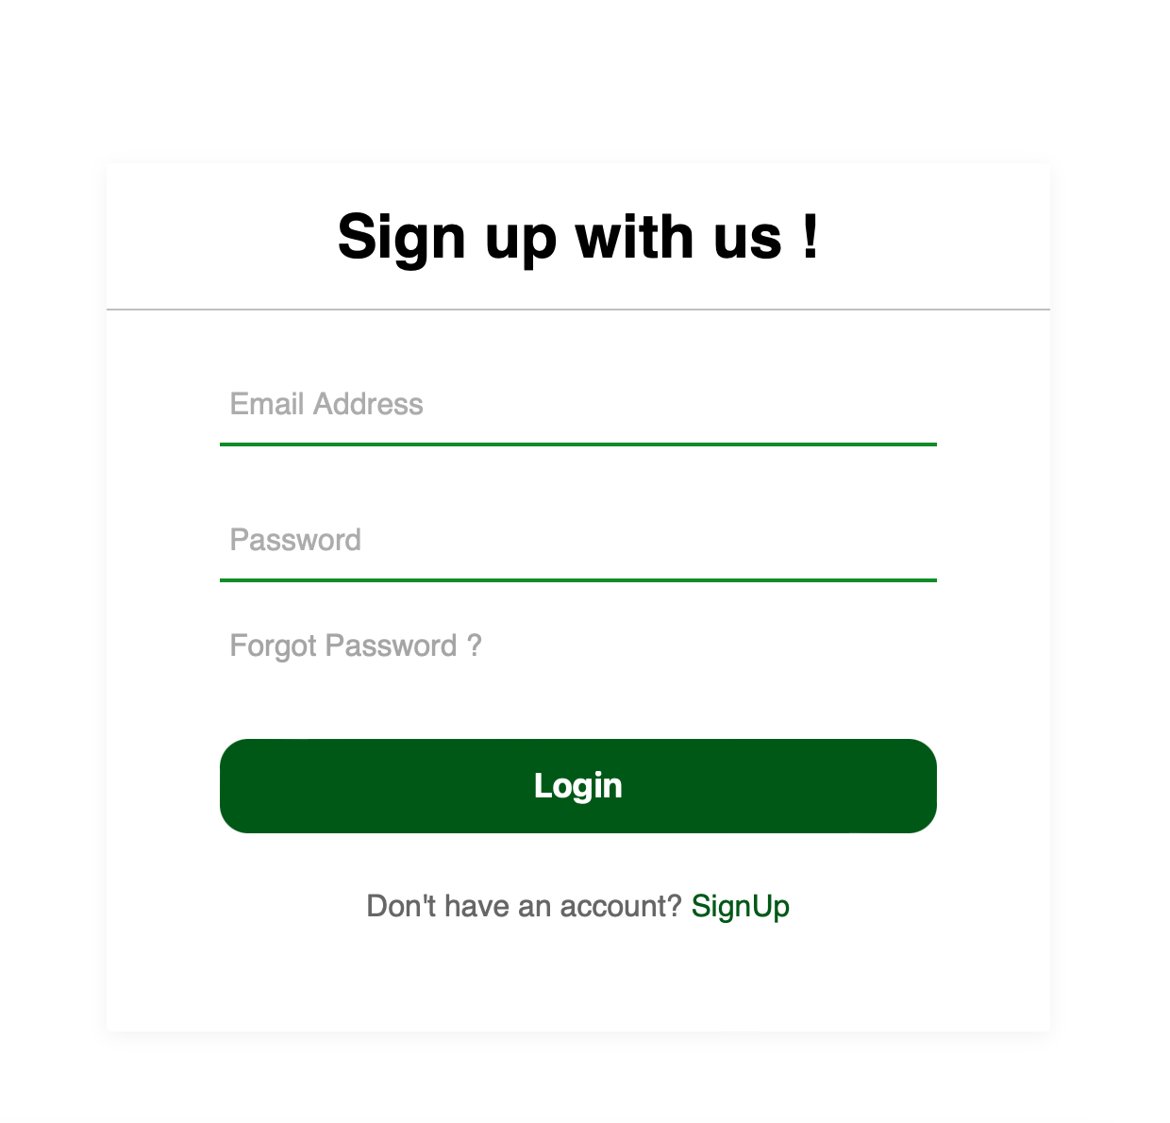
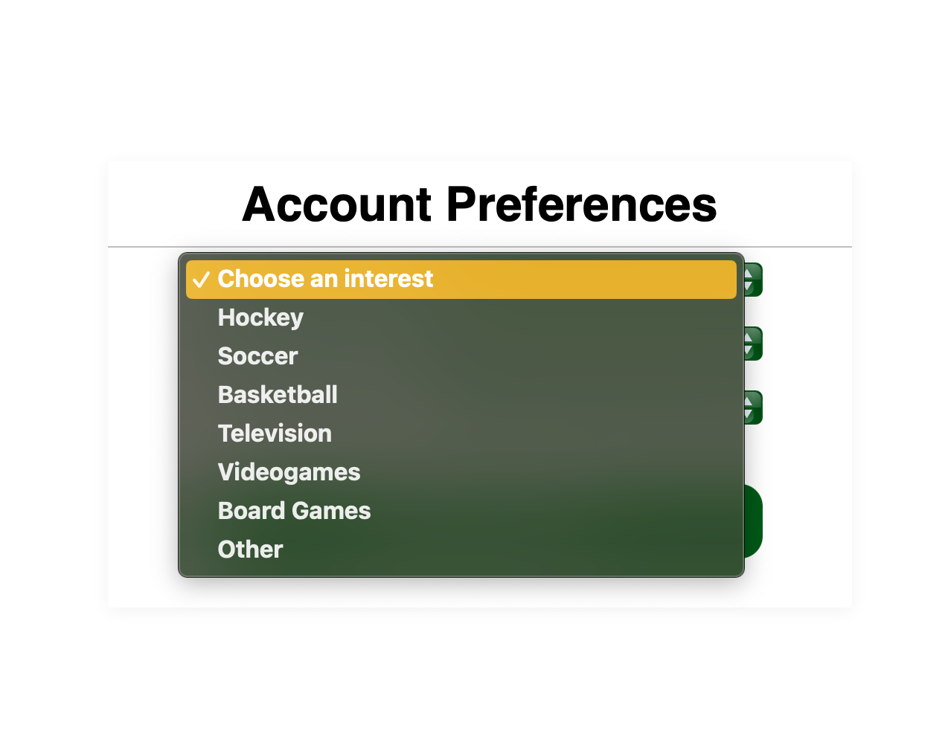

Slide 7
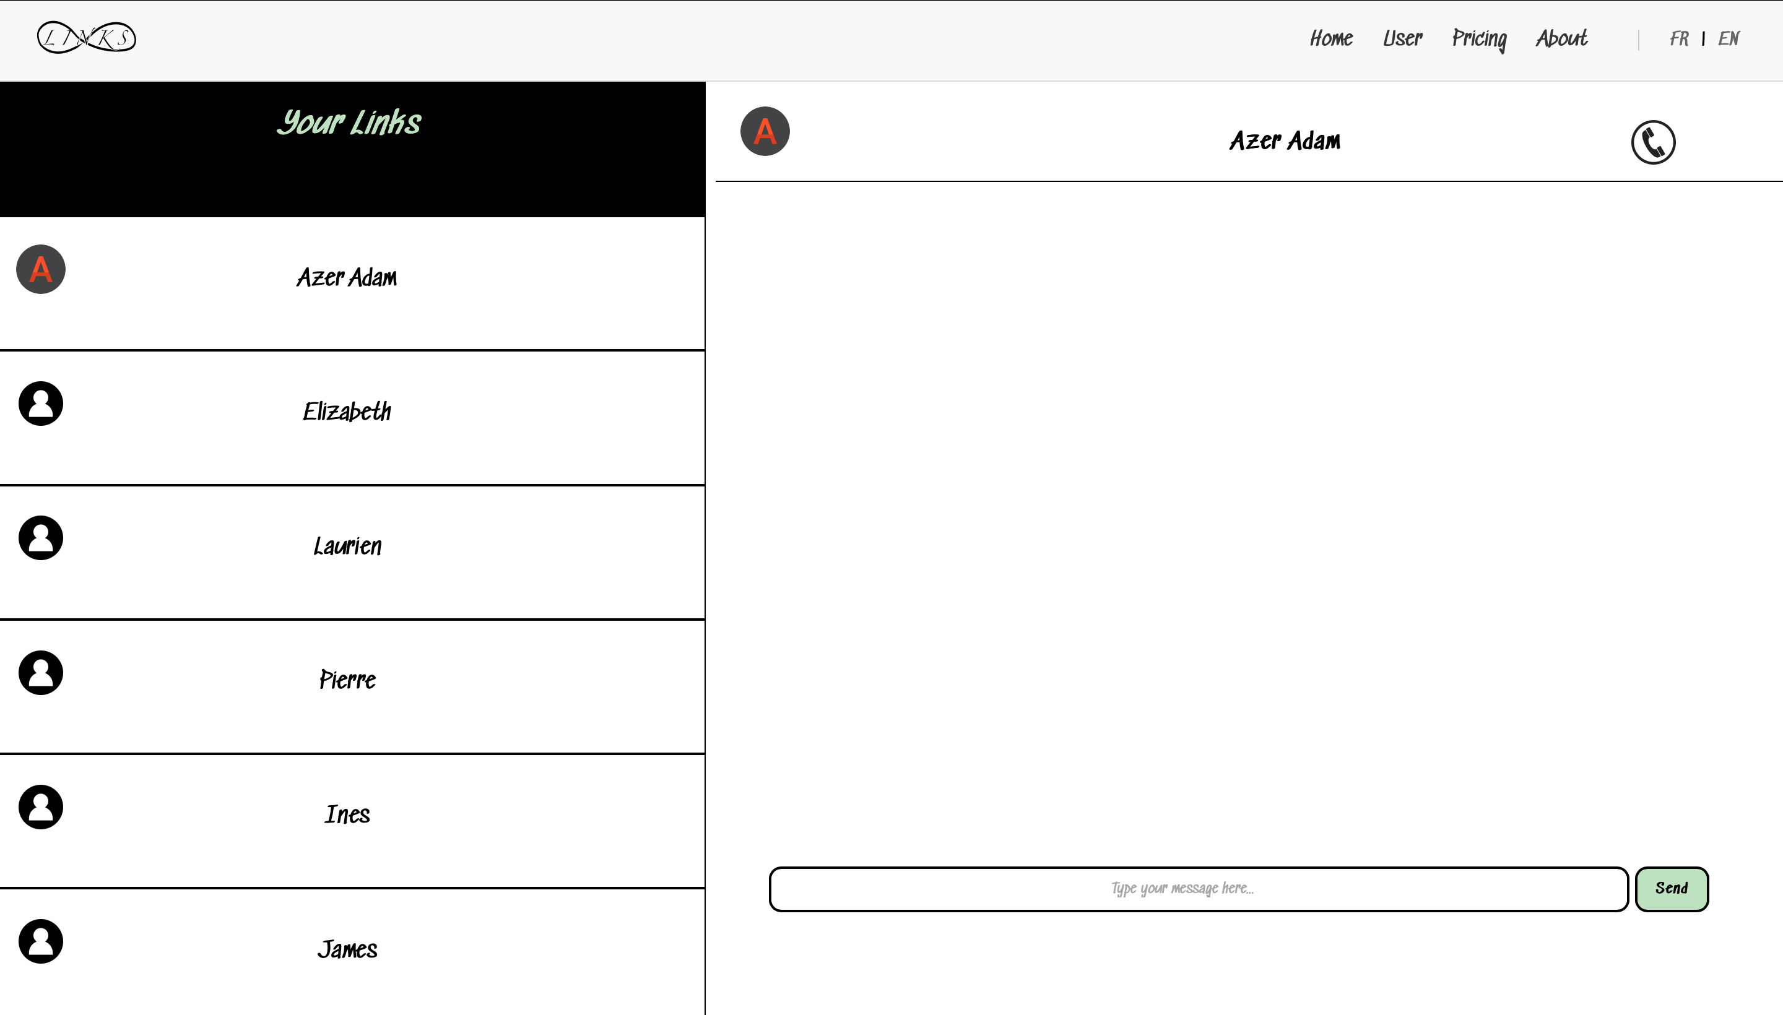
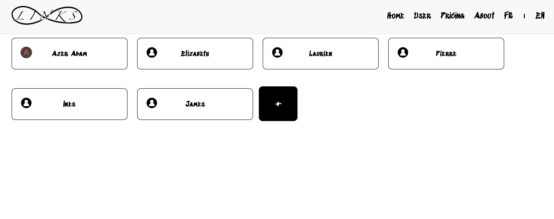

Slide 8

Marketing Opportunity
Notes:
Page 7 for Laurien Michel , specifically built for Market opportunity

Slide 9


Product Features
“Free Features” → “Open Access Tools”
“Premium ($10mo)” → “Value-Driven Premium”
“University Partnerships” → “Collaborative Engagement”
University Experience Meets Career Tools
*Scaled EdTech for Student Growth
*Built Social Platforms for Student Networks
*Student Affairs Meets Tech Design
Notes:
Page 7 for Laurien Michel , specifically built for Market opportunity

Slide 10
Modèle économique
Flux de revenus et tarifaction
Économie unitaire et flux
Modèle freemium
Tarification à l'usage
Coût d'acquisition client
Stratégie d’acquisition de clients
Valeur de vie client
Stratégie de fidélisation
Tarification par abonnement
Marge unitaire
Acquisition organique
89%
Acquisition payante
Amélioration continue
Commision
Flux financier
Publicité
78%
Partenariats et
affiliations
Programme de récompenses et parrainage
Stratégie communautaire
1,200+
15+
Optimisation du tunnel de conversion
Automatisation
Service client performant
Notes:
(Pierre)Part 5. 1 page only

Slide 11
Our
Advantage
The Competition
Discord: Gaming focus, lacks academic
verification.
LinkedIn: Professional emphasis, misses student social needs.
Instagram: Promotes superficial connections over academics.
Notes:
6. Competittive Landscape

Slide 12
Our Unique Advantage
Our Advantage
Campus-Exclusive: Email verification ensures authentic communities.
Academic Focus: Study partner matching and course-based connections.
University Integration: Deep integration with campus life and events.
Notes:
6. Competittive Landscape

Slide 13
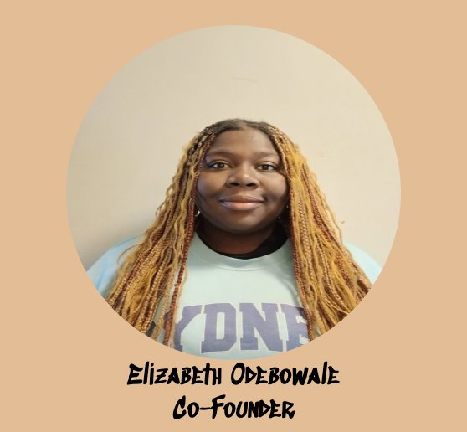
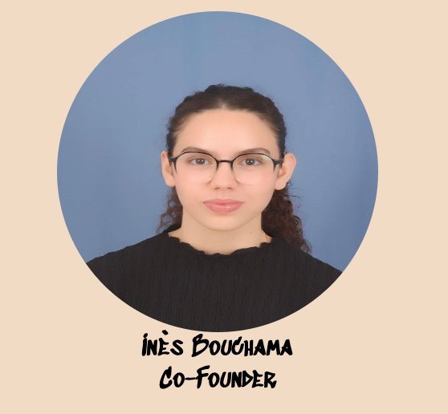
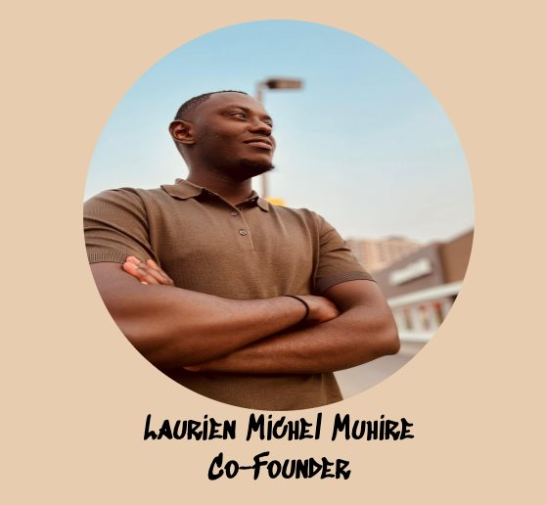
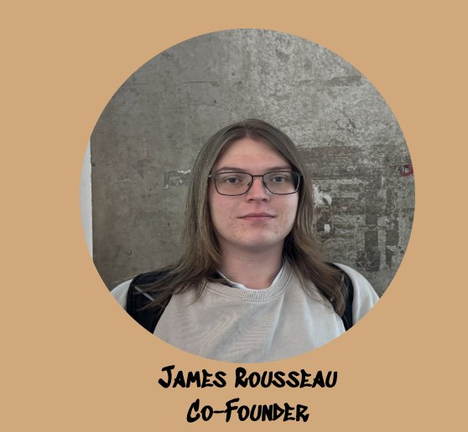
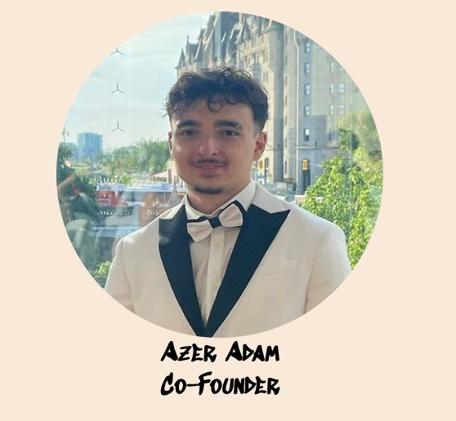

Meet The Team

Slide 14
Meet The Team

Slide 15




Financial Projection Growth Plan
Connections: Easing transition into a new environment
Promotions: Promoted on main stream apps
Engagement: Ensure rapid growth through algorithms by engaging the youth and sharing our application throughout their own network.
Notes:
Number 9:James page

Slide 16
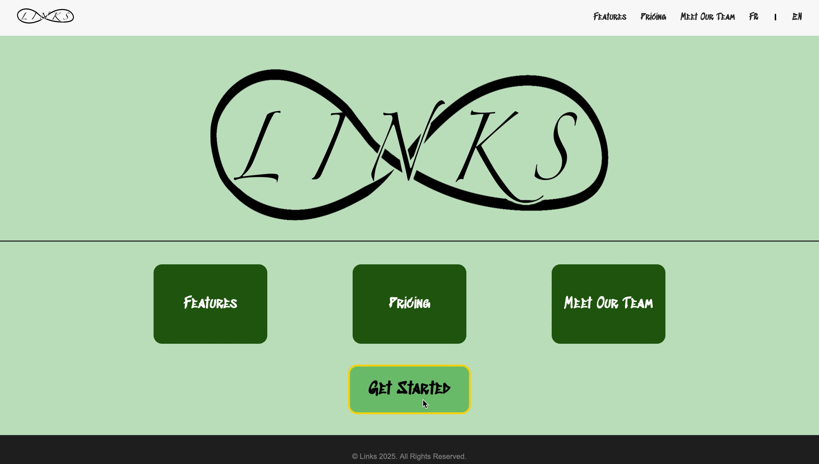
https://links-seg2900.github.io/html-pages/Homepage.html

Slide 17

THANK YOU

